Slide 1
120 years of Olympic history: athletes and results
Data Analysis Project Proposal for Sport statistics
04/29/2022
Gunel Mastaliyeva

Slide 2
CONTEXT
This is a historical dataset on the modern Olympic Games, including all the Games from Athens 1896 to Rio 2016.
This data is taken from this link: www.sports-reference.com
The dataset contains 271116 rows and 15 columns.

Slide 3
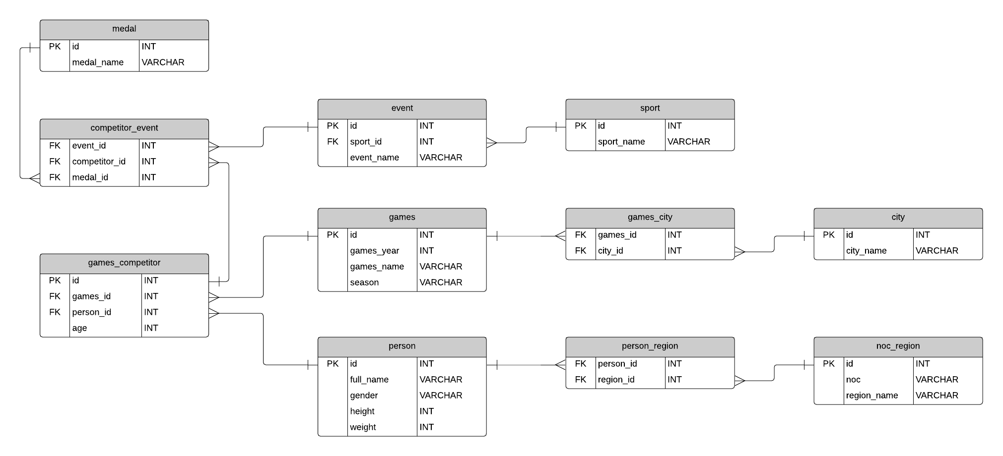
Olympics Athletes Dataset: ER Diagram

Slide 4
Table OF CONTENTS
Questions
Initial Explorations
Insights
Conclusion

Slide 5
SECTION 1:
Questions to answer
How are the contestants distributed per gender?
Which countries send the highest number of athletes to the Olympics?
What is the overall trend of the Olympics?
Which Country took home the majority of medals?
Which season has highest number of gold medals?

Slide 6
SECTION 2:
Initial Hypothesis
Men have larger share of medals in comparison with female contestants
USA , Russia took majority of medals.
Summer season shows highest number of gold medals in comparison with Winter.

Slide 7
SECTION 3:
Data Analysis Approach
I will be looking for some metrics related with gender, country, overall trends and so on.
I will use main SQL functions to get the results of queries correctly.
I will use visualizations in Databrick Environment and Tableau Public.

Slide 8

Initial Findings
Gold 13372
Bronze 13295
Silver 13116
271116 athletes

Slide 9
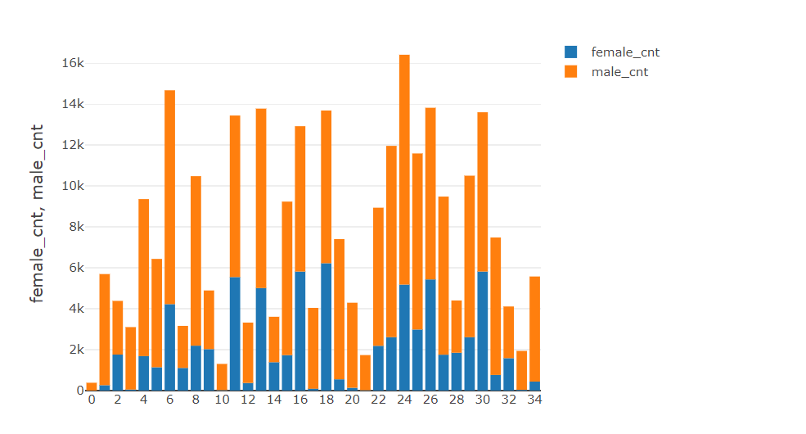
GENDER PROPORTION
According to the graph,
majority of contestants are male.

Slide 10
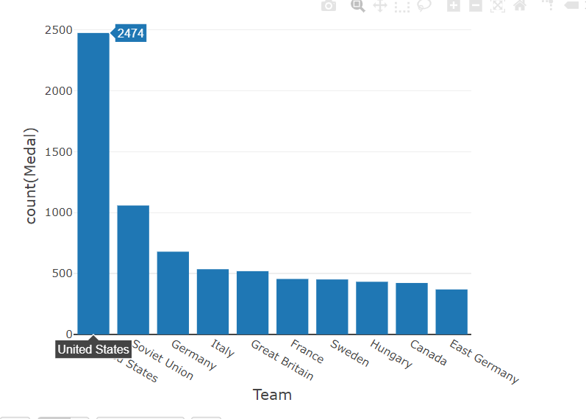
TOP 5 COUNTRIES WHICH HAVE GOLD MEDALS
According to the chart below, United States is leading in comparison with other countries with the highest number of team participation.

Slide 11
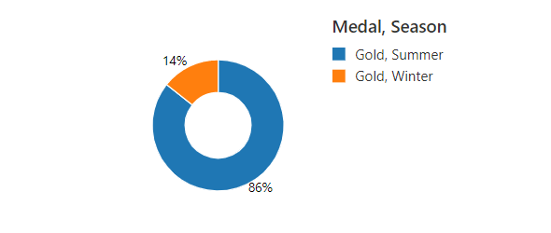
Initial Findings
According
to donut chart below, majority of gold winner are in Summer season.

Slide 12
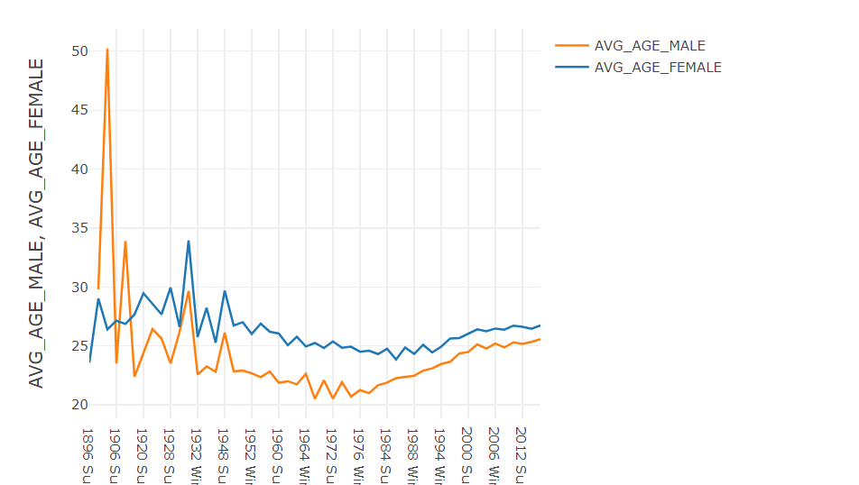
DEEPER EXPLORATIONS
According to graph, in average male contestants are older than female contestants.

Slide 13
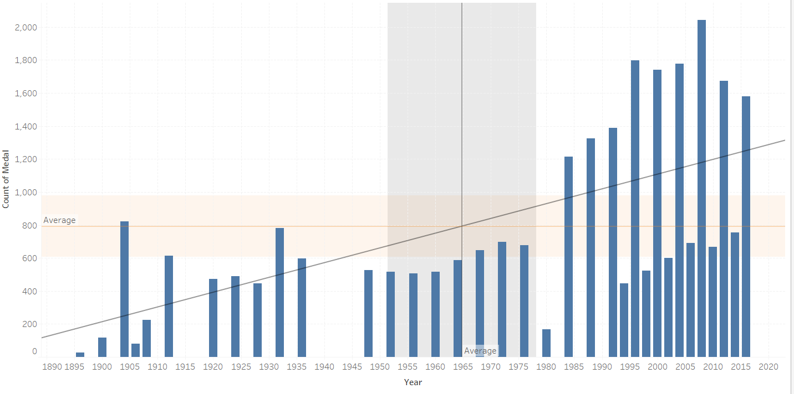
DEEPER ANALYSIS: Medals DISTRIBUTON OVER THE YEAR
According to the bar graph there is obvious gap in 1915 and 1940.
The progression line shows trend is going up according to the graph.

Slide 14
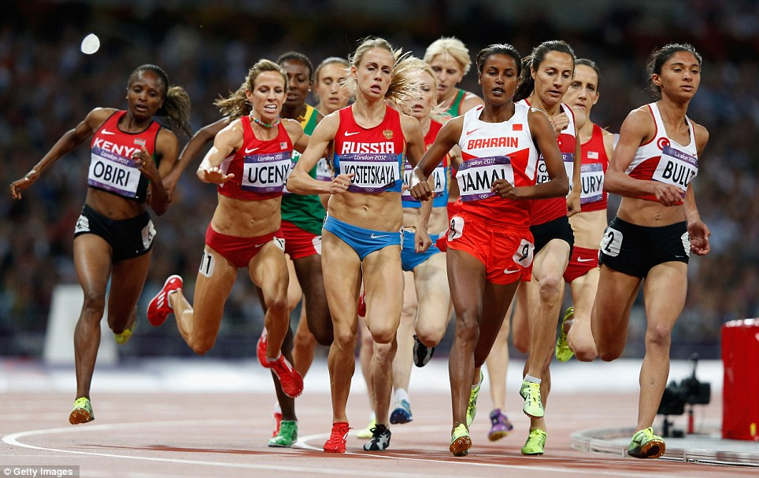
WOMEN IN ATHLETICS

Slide 15
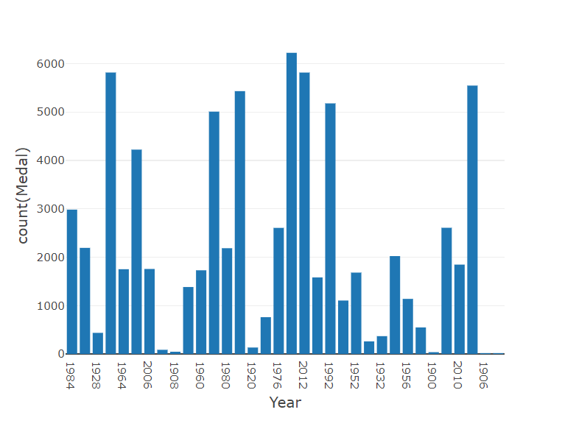
WOMEN IN ATHLETICS
According to the graph, highest number of gold medal winner by female athletes are in 2016.

Slide 16
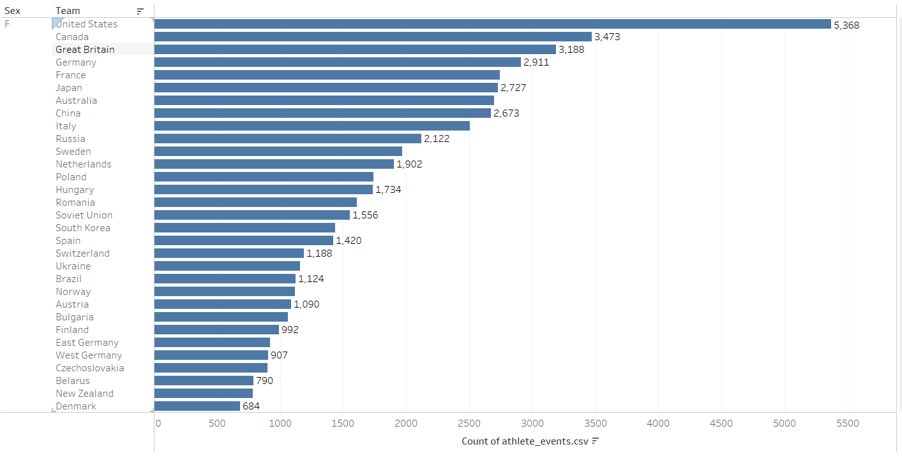
FEMALE ATHLETS BY COUNTRY
According to the graph, United States, Canada and Great Britain is leading on the number of female contestants.

Slide 17
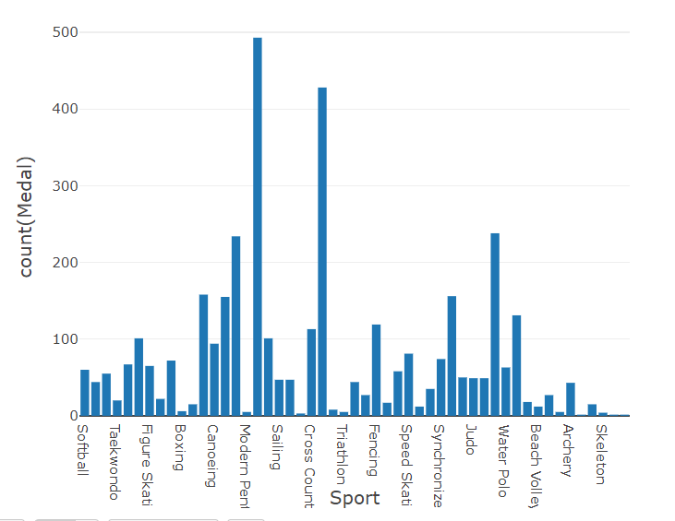
SPORTS IN WHICH FEMALES
WON MAX GOLD MEDAL
Females are good at swimming and athletics according to the bar graph.

Slide 18
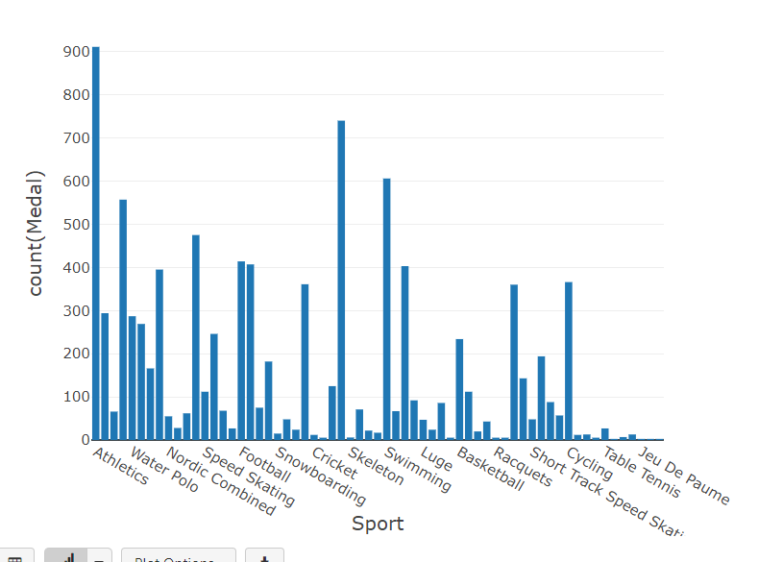
SPORTS IN WHICH FEMALES
WON MAX GOLD MEDAL
Males are good at Rowing, Swimming and Athletics according to the bar graph.

Slide 19
CONCLUSION
Overtime number of contestants were increasing .
Gender equality increased in different sport types.
Databricks link: https://community.cloud.databricks.com/?o=1361049106077391#notebook/4334494184065066/command/4334494184065076

Slide 20

Thank you for reading

